Slide 1
Health Risk Assessment (HRA) (Health Assessment Tool – HAT) Completion upon Enrollment Sales Agent Incentive Program
How To Guide

Slide 2
Program Overview
The Health Assessment Tool (HAT), also known as a health risk assessment (HRA), is required by CMS and is to be completed initially by all members and annually thereafter by all SNP members.
HRAs are questionnaires that evaluate lifestyle factors and health risks of an individual.
The Plan has now made the HAT form available to Sales Agents during enrollment via the online enrollment application on the agent portal.
A Sales Agent Incentive will be tied to obtaining HATs for enrollees during enrollment.

Slide 3
Incentive Payout Terms
All Freedom & Optimum PBPs are eligible!
Enrollee must become a member and must stay on the plan for at least 30 days. Payment will not be issued if the member disenrolls during their first month (i.e. effective 1/1 but terms 1/31).
Point of sale HRA/HAT completions only via electronic form. HRA/HAT incentive for sales does not include paper forms, Connecture or Sunfire applications.
You may submit an HRA/HAT up to five (5) days after the application has been submitted (i.e. if beneficiary doesn’t want to fill it out day-of but changes their mind within 5 days, you can access “incomplete HRAs” on the OEC through the portal.
While the Plan encourages enrollees to complete the entire HRA/HAT, the Plan understands that enrollees may be hesitant to answer individual question. To qualify for the sales agent incentive, the enrollee needs to answer at least 80% of questions.

Slide 4
Incentive Payout Terms (cont.)
For application effective dates 12/1/2022 through 4/1/2023:
Incentive for HRA/HATs submitted for D-SNP & C-SNP plans = $150.00
Incentive for HRA/HATs submitted for all other PBPs = $65.00
For application effective dates 5/1/2023 & onward:
Incentive for HRA/HATs submitted for All PBPs = $65.00

Slide 5
What is a Health Risk Assessment/Health Assessment Tool (HRA/HAT)?
A questionnaire that evaluates lifestyle factors and health risks of an individual.
Required by the Centers for Medicare and Medicaid Services (CMS) and is to be completed initially by all members and annually thereafter by all SNP members.
Answers to questions will not affect insurance coverage.

Slide 6
How does the Plan use the HRA/HAT?
Determine if the member might benefit from receiving a call from a nurse or Social Worker. Many members have experienced the advantages of participating in Case and Disease Management.
Develop individualized care plans to facilitate improved health outcomes.
May share the HRA/HAT answers with Primary Care Physician (PCP).
Generate a Health Appraisal Profile that helps the member identify potential risks as well as resources to overcoming barriers.

Slide 7
Additional HRA/HAT Information
If enrollee asks you or attempts to discuss with you his/her medical condition(s), medications and/or symptoms unrelated to the health assessment tool questions: I am not a clinician and would encourage you to speak with your doctor about your health concerns.
If enrollee expresses significant difficulty managing own health care needs and coordination of care or financial burdens: It sounds like you are experiencing some difficulty. Once you become a member of the Health Plan, you will have access to the Case and Disease Management Department who may be able to assist you.
If enrollee opts out completing HRA/HAT form with sales agent after enrollment application: Advise enrollee to look for the paper form in the mail as opting out with sales does not opt the enrollee out of process in the future. Enrollees may also receive telephone calls prompting them to complete the HRA/HAT if not completed with sales agent or subsequent paper forms. However, if completed with sales agent, enrollee will not receive initial paper HRA/HAT form via mail and will be moved forward approximately 9 months for renewal as part of ongoing check of health status and potential needs.

Slide 8
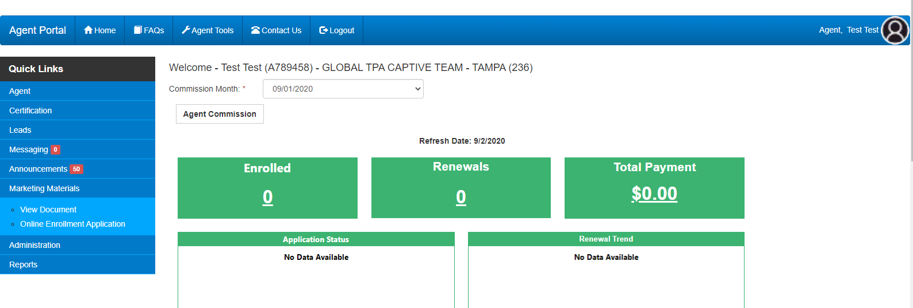
Agent Portal
Log into the Agent Portal via laptop/computer and click on Marketing Materials to access the Online Enrollment Application

Slide 9
Online Enrollment Application
Select “Click here to Begin Online Enrollment” and complete the online enrollment application

Slide 10
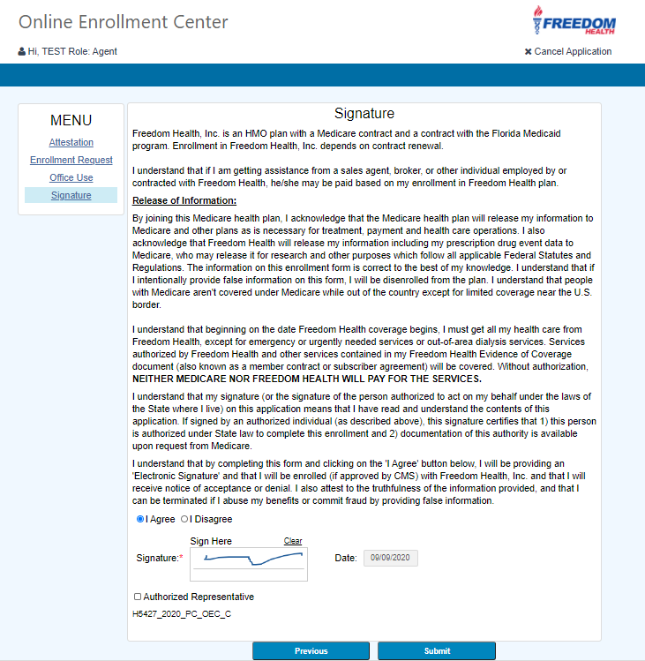
Application Signature Page
Once application is completed, the signature page will appear for the enrollee to sign the application.
Once enrollee signs, click “Submit” to submit the application.
It is important that the entire application be complete (including signature) prior to moving forward offering to assist the enrollee in completing the HRA/HAT.

Slide 11
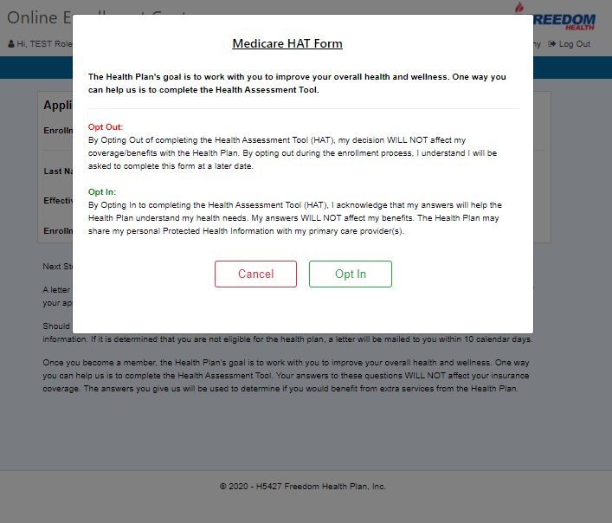
HRA/HAT Opt-In/Opt-Out Message
Once application has been submitted, the Medicare HRA/HAT Form Opt-In/Opt-Out Message is displayed.
Language indicates that the HRA/HAT completion/responses does not affect enrollment decision or benefits. Enrollees can elect not to complete the HRA/HAT with the sales agent.

Slide 12
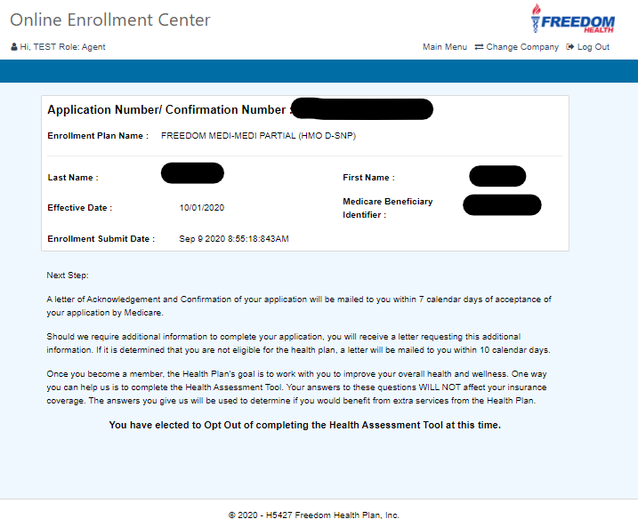
HRA/HAT – Opt-Out
If enrollee does not want to participate in completing the HAT, click “Cancel”
The Application Number/Confirmation Number page will then appear with the message “You have elected to Opt-Out of completing the Health Assessment Tool at this time”. Process is complete. Please remind the enrollee that the HAT will be offered again in the future.

Slide 13
HRA/HAT – Opt In
If enrollee does want to participate in completing the HRA/HAT, click “Opt-In”

Slide 14
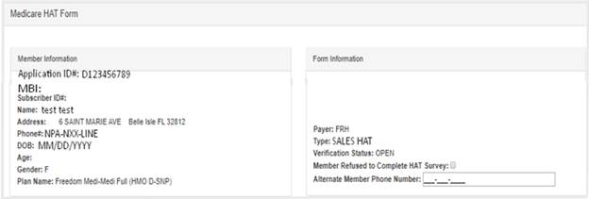
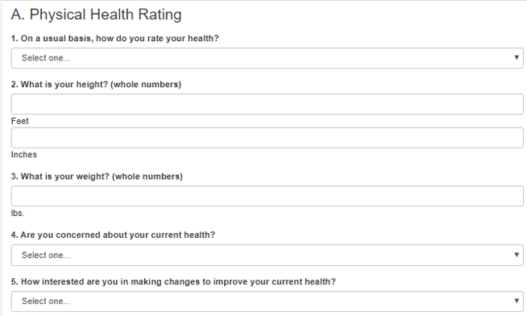
HRA/HAT Form
The HRA/HAT form will then open with enrollee data populated from the application.
There are 36 questions in total for enrollees to complete.
Click “Next” when enrollee has completed the questions.

Slide 15
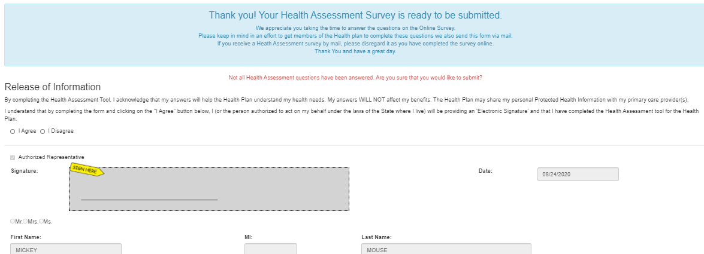
HRA/HAT – Release of Information/Submission
Enrollee will need to select “I Agree” and sign the Release of Information to submit the HRA/HAT.
If enrollee decides to back out and selects “I Disagree”, HRA/HAT will NOT be submitted.

Slide 16
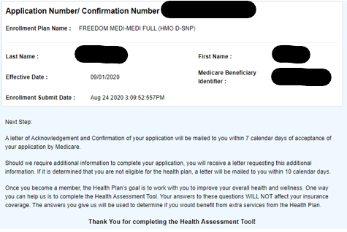
HRA/HAT – Confirmation Page
The Application Number/Confirmation Number page will then appear with the message “Thank You for completing the Health Assessment Tool”. Process is complete.

Slide 17
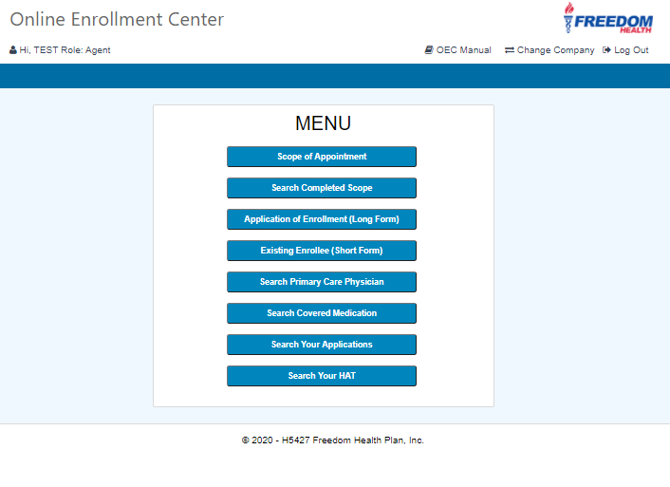
Search for Completed HRA/HATs
If you would like to search for your completed HATs, in the Online Enrollment Application screen select “Search your HAT”

Slide 18
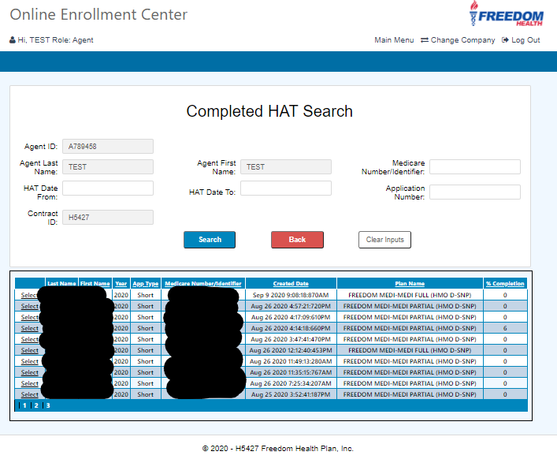
Search for Completed HRA/HATs
Fill out search criteria and select “Search”.
Click on select to bring up a PDF of the completed form.
The % Completion column will indicate what % of the HAT was completed. To qualify to receive the incentive, at least 80% of the HAT must be completed. Members must stay on the Plan for at least 30 days.

Slide 19
Questions?
Contact Agent/Broker Services at:
1-877-877-0539
1-877-877-0538 (Spanish)

